Slide 1

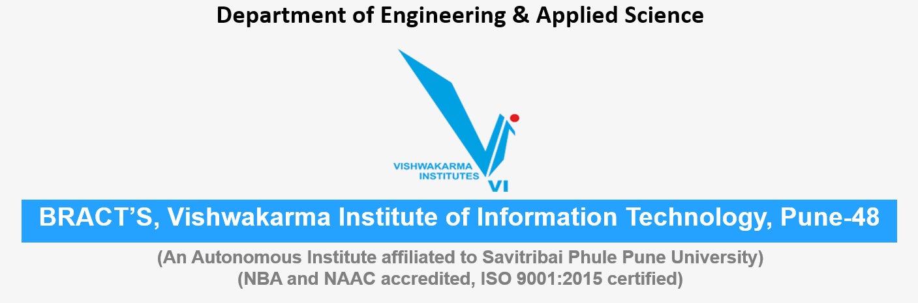
NOISE POLLUTION Energy, Water, Environment Sustainability
Roll No. | PRN | Name of student | Div. | VIIT email ID
1405 | 22110075 | Yash Gavit | N | yash.22110075@viit.ac.in
1412 | 22110206 | Prasad Nathe | N | prasad.22110206@viit.ac.in
1418 | 22110305 | Sahil Savardekar | N | sahil.22110350@viit.ac.in
1421 | 22110398 | Siddhesh Khairnar | N | siddhesh.22110398@viit.ac.in

Slide 2

What is Noise Pollution
Noise pollution is an invisible danger. It cannot be seen, but it is present nonetheless, both on land and under the sea. Noise pollution is considered to be any unwanted or disturbing sound that affects the health and well-being of humans and other organisms.
Sound is measured in decibels. Sounds that reach 85 decibels or higher can harm a person’s ears. Noise pollution impacts millions of people on a daily basis. The most common health problem it causes is Noise Induced Hearing Loss (NIHL). Exposure to loud noise can also cause high blood pressure, heart disease, sleep disturbances, and stress. These health problems can affect all age groups, especially children. Many children who live near noisy airports or streets have been found to suffer from stress and other problems, such as impairments in memory, attention level, and reading skill.
Noise pollution also impacts the health and well-being of wildlife. Increasing noise is not only affecting animals on land, it is also a growing problem for those that live in the ocean. Ships, oil drills, sonar devices, and seismic tests have made the once tranquil marine environment loud and chaotic.
Group 2 , Department of Engineering and Applied Sciences, VIIT, Pune-48

Slide 3
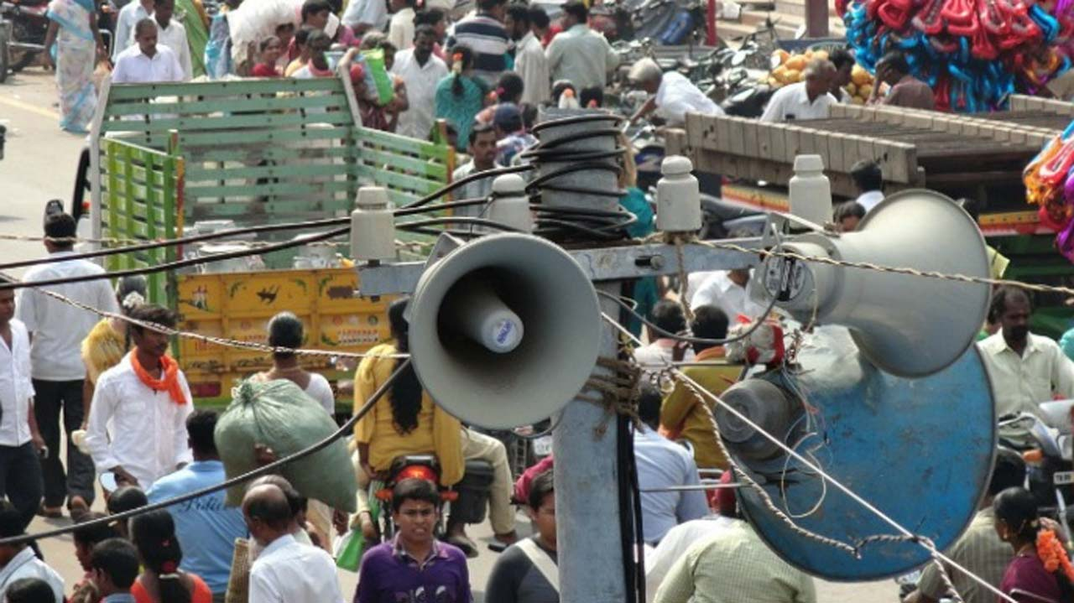
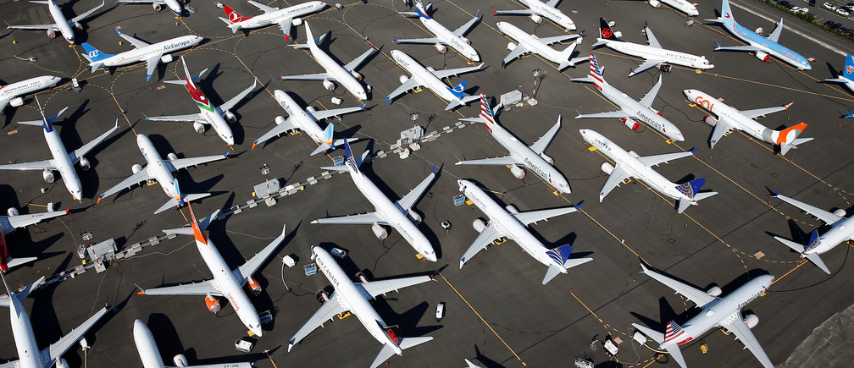
Sources of Noise Pollution
Events: Weddings, public gatherings involve loudspeakers to play music resulting in the production of unwanted sound in the neighbourhood
Poor Urban Planning: In most of the developing countries, poor urban planning also play a vital role. Congested houses, large families sharing small space, parking lots, street noise, honking, commercial zone leads to noise pollution which disrupts the environment of society.
Air traffic noiseThere are fewer aircraft flying over cities than there are cars on the roads, but the impact is greater: a single aircraft produces 130 dB.
Group 2 , Department of Engineering and Applied Sciences, VIIT, Pune-48

Slide 4
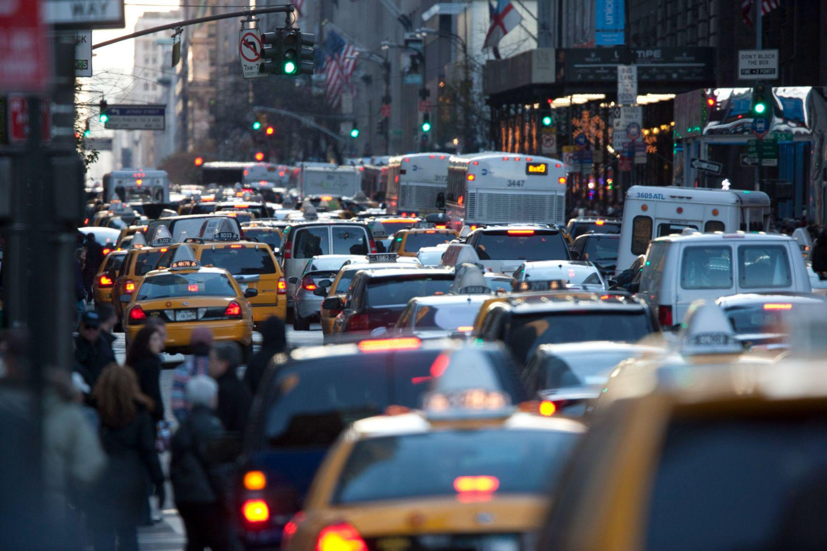
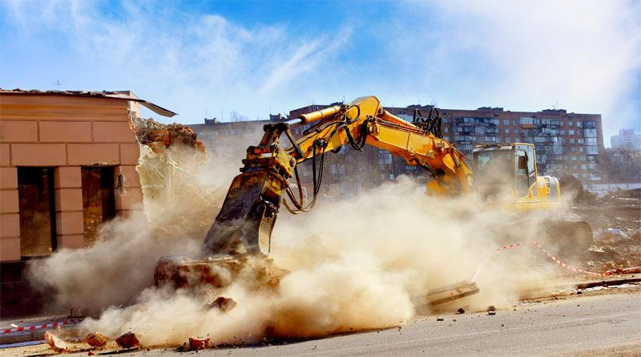
Sources of Noise Pollution
Traffic noise
Traffic noise accounts for most polluting noise in cities. For example, a car horn produces 90 dB and a bus produces 100 dB.
Construction sites
Building and car park construction and road and pavement resurfacing works are very noisy. For example, a pneumatic drill produces 110 dB.
Miscellaneous Sources:
The automobile repair shops, market places, schools, colleges, bus stands, and railway stations etc. are other sources of noise pollution.
Group 2 , Department of Engineering and Applied Sciences, VIIT, Pune-48

Slide 5

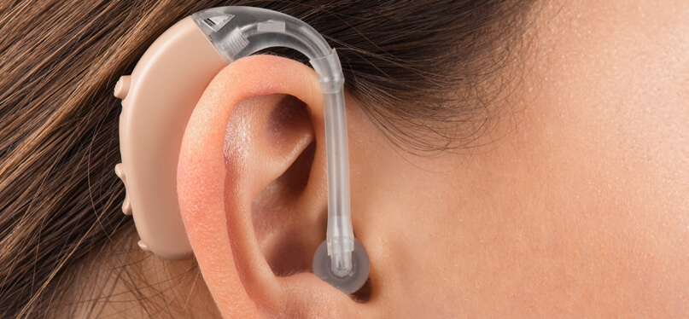
Effects of Noise Pollution
1) Auditory effects:
It includes deafness or auditory fatigue.
Deafness or impaired hearing:
Prolonged exposures to noise lead to gradual deterioration of internal ear and subsequently hearing loss or deafness. It may occur due to continuous exposure to noise level of more than 90 dB. It may be temporary or permanent. Explosions or other high intensity sounds can also cause immediate deafness by rupturing the ear drums or damaging the cochlea. Many time hearing loss is attributed to occupation.
Auditory fatigue:
It is defined as a temporary loss of hearing after exposure to sound. Continuous humming sound such as whistling and buzzing in the ears.
Group 2 , Department of Engineering and Applied Sciences, VIIT, Pune-48

Slide 6
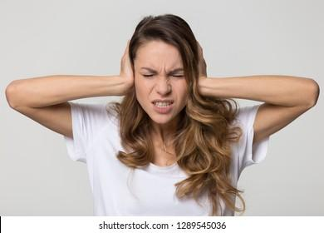

Effects of Noise Pollution
2) Non auditory effects:
These are:-
Irritation and annoyance:
Noise, sometimes, leads to emotional disturbances and makes people loose their temper. It can interfere with proper rest and sleep. Annoyance seems to increase with the loudness of the sound.
Physiological effects:
It includes dilation of the pupils, paling of skin, tensing of voluntary muscles, diminishing of gastric secretions, increase in diastolic blood pressure and the sudden injection of adrenalins into blood stream which increases neuromuscular tension, nervousness, irritability and anxieties. It can adversely affect the development of unborn babies.
Other health effects: Noise is also associated with headache, giddiness, sweating, nausea, fatigue, difficulty in breathing, disturbed sleep pattern, psychological stress.
Group 2 , Department of Engineering and Applied Sciences, VIIT, Pune-48

Slide 7
Remedial Measures to control Noise Pollution wrt any one case study
.
Group 2 , Department of Engineering and Applied Sciences, VIIT, Pune-48

Slide 8
Remedial Measures to control Noise Pollution wrt any one case study
Group 2 , Department of Engineering and Applied Sciences, VIIT, Pune-48

Slide 9
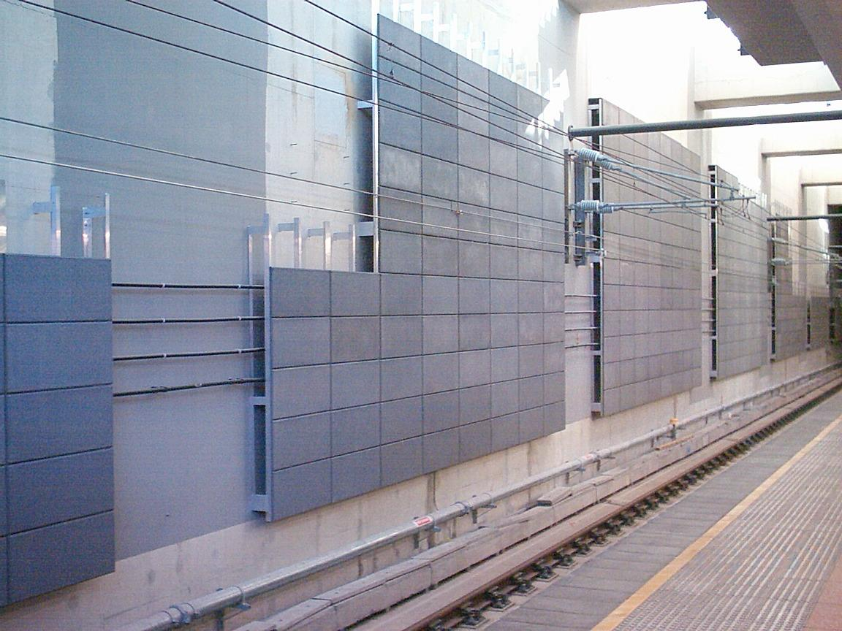
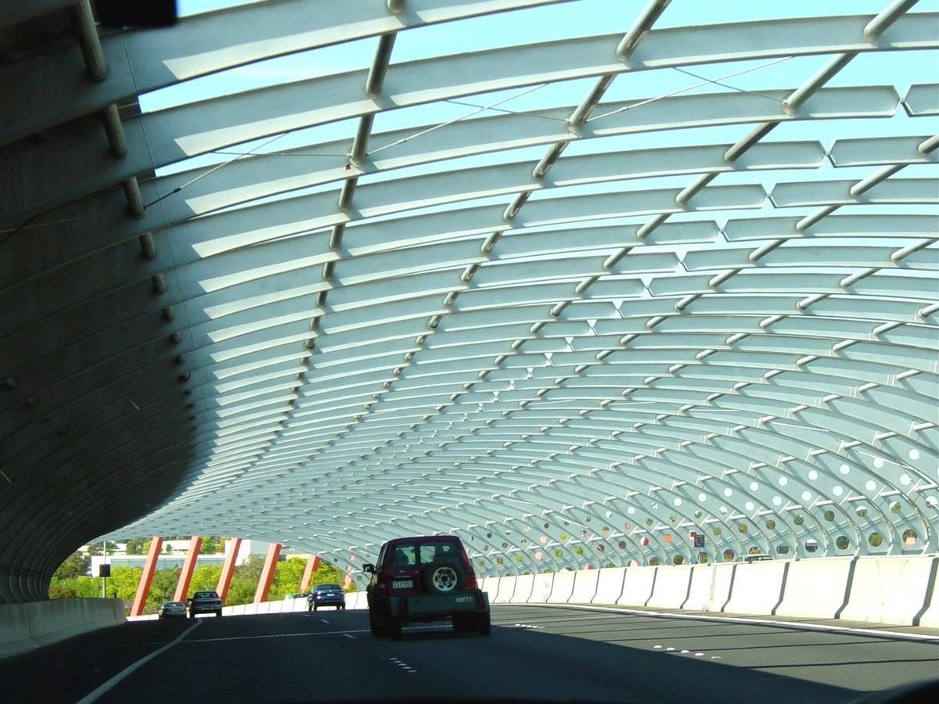
Environmental Engineering for curbing Noise Pollution
1.Sound barrier walls
A noise barrier (also called a soundwall, noise wall, sound berm, sound barrier, or acoustical barrier) is an exterior structure designed to protect inhabitants of sensitive land use areas from noise pollution.
2.Highway noise barrier
Highway noise barriers are designed to mitigate the effects of traffic noise along the highway. Noise barriers primarily block the direct path of the sound between the source on the highway and the receiver exposed to the sound.
Group 2 , Department of Engineering and Applied Sciences, VIIT, Pune-48

Slide 10
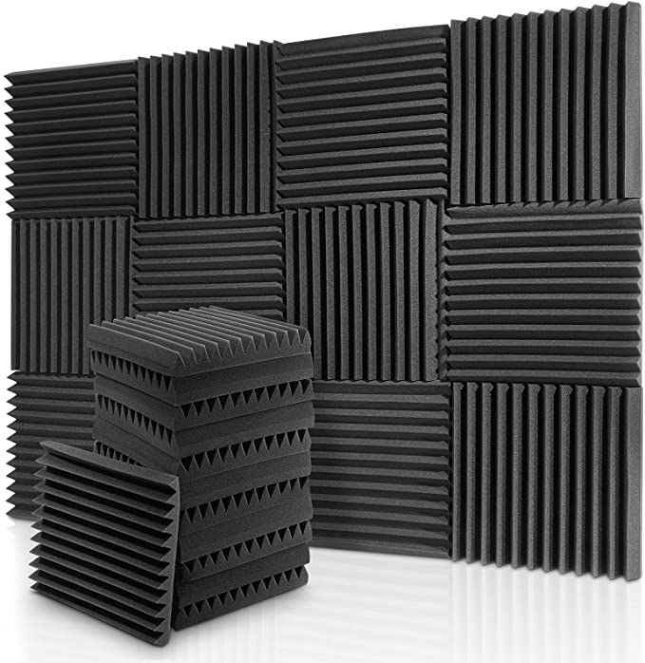
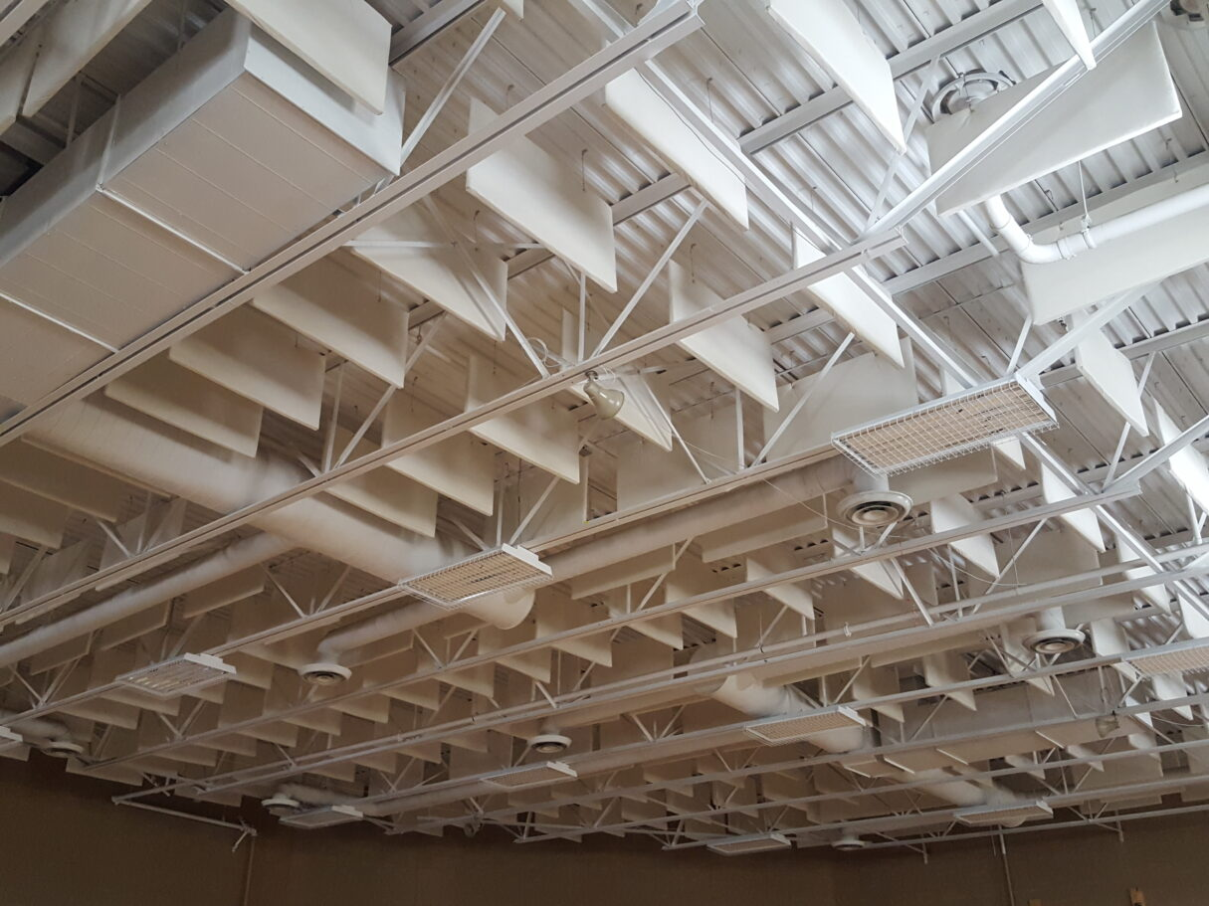
Environmental Engineering for curbing Noise Pollution
3.Noise cancelling wall panels
They can absorb acoustic energy through two mechanisms:
When they are soft materials, they absorb due to the deformation that occurs when the sound wave hits them. When they are porous materials, they absorb by the vibration of the air contained in its pores, which loses energy by friction against their edges.
4.Noise reduction baffles
A sound baffle is a construction or device which reduces the strength (level) of airborne sound. Sound baffles are a fundamental tool of noise mitigation, the practice of minimizing noise pollution or reverberation.
Group 2 , Department of Engineering and Applied Sciences, VIIT, Pune-48

Slide 11
Wrap and Related Outcome

Slide 12
References and Resources for Further Details
1.Effect of Noise Pollution and its Solution Through Eco-Friendly Control Devices in the North East India
Author : Surabhi Srivastava
https://www.sciencedirect.com/science/article/pii/S1877705812019376
2.Noise Reduction Devices Used in Industries
Author : Vibha D
https://www.environmentalpollution.in/noise-2/reduction-devices/list-of-noise-reduction-devices-used-in-industries/6294
3.Noise Pollution Hardcover – 1 July 2016
Author : P. R. . Trivedi
4.NOISE POLLUTION AND ITS CONTROL (PB 2019) – 1 January 2019
Author : K.J. Polak
https://www.environmentalpollution.in/noise-2/reduction-devices/list-of-noise-reduction-devices-used-in-industries/6294
Group 2 , Department of Engineering and Applied Sciences, VIIT, Pune-48

Slide 13
Thank You
Group 2 , Department of Engineering and Applied Sciences, VIIT, Pune-48
13

